Slide 1

Roadmap
introduction
error detection, correction
multiple access protocols
LANs
addressing, ARP
Ethernet
switches

Slide 2









Multiple access links, protocols
two types of “links”:
point-to-point
point-to-point link between Ethernet switch, host
PPP for dial-up access
broadcast (shared wire or medium)
old-fashioned Ethernet
upstream HFC in cable-based access network
802.11 wireless LAN, 4G/4G. satellite
点对点
以太网交换机，主机之间的点对点链路
用于拨号访问的PPP（点对点协议）
广播（共享线或媒介）
以太网
基于电缆接入网的上行HFC
局域网，4/5G,卫星
shared wire (e.g.,
cabled Ethernet)
shared radio: 4G/5G
shared radio: WiFi
shared radio: satellite
humans at a cocktail party
(shared air, acoustical)

Slide 3
Multiple access protocols
单一共享广播频道
两个或多个节点同时传输:干扰．
碰撞：如果节点同时接收到两个或多个信号
single shared broadcast channel
two or more simultaneous transmissions by nodes: interference
collision if node receives two or more signals at the same time
媒体访问控制(MAC)
协议确定节点如何共享信道，例如确定节点何时可以传输
检测、避免和从碰撞中恢复的策略
media access control (MAC) protocol
determines how nodes share channel, i.e., determine when node can transmit
Strategies for detecting, avoiding, and recovering from collisions

Slide 4
MAC protocols: taxonomy
分类
信道划分
分成更小的(时间段、频率、代码)
单独使用
例如，时分，频分
轮流
节点是轮流的，但是有更多的节点需要发送更长的时间
例如:令牌环网络
随机访问
通道不分割，允许碰撞，但使用策略恢复．
例子:以太网,Wifi
three broad classes:
channel partitioning
divide channel into smaller “pieces” (time slots, frequency, code)
allocate piece to node for exclusive use
Examples: Time Division Multi-Access (TDMA) and Frequency Division Multi-Access (FDMA) for cellular communications
“taking turns”
nodes take turns, but nodes with more to send can take longer turns
Example: token ring networks
random access
channel not divided, allow collisions, but use strategies to recover
Examples: Ethernet, Wifi

Slide 5
An ideal multiple access protocol
理性情况
一个节点，R
M个节点，R/M
分散，单个故障不影响其它
简单
given: broadcast channel of rate R bps
Desirable characteristics:
1. when one node wants to transmit, it can send at rate R.
2. when M nodes want to transmit, each can send at average rate R/M
3. fully decentralized:
no special node to coordinate transmissions
4. simple

Slide 6
Channel partitioning MAC protocols: TDMA
TDMA: time division multiple access
access to channel in “rounds”
each station gets fixed length slot (length = packet transmission time) in each round (fair); eliminates collisions
unused slots go idle
example: 6-station LAN, 1,3,4 have packets to send, slots 2,5,6 idle
TDMA
每轮访问频道
固定时隙，消除碰撞
不使用时闲置
6-slot
frame
6-slot
frame
1
3
4
1
3
4

Slide 7
Channel partitioning MAC protocols: FDMA
FDMA: frequency division multiple access
channel spectrum divided into frequency bands
each station assigned fixed frequency band (fair); avoids collisions
unused frequency bands remain idle
example: 6-station LAN, 1,3,4 have packet to send, frequency bands 2,5,6 idle
FDMA
信道频谱分为频带
各台站分配固定频带(公平);避免碰撞
time
frequency bands
FDM cable

Slide 8
Random access protocols
when node has packet to send
transmit at full channel data rate R.
no a priori coordination among nodes
two or more transmitting nodes: “collision”
random access MAC protocol specifies:
how to detect collisions
how to recover from collisions (e.g., via delayed retransmissions)
examples of random access MAC protocols:
ALOHA, slotted ALOHA
CSMA, CSMA/CD, CSMA/CA
全速R发送
没有有线协调
>=2时碰撞
随机访问MAC协议
如何检测碰撞，如何恢复

Slide 9
Evolution of Random Access protocols
纯aloha
立即以概率p发送
Pure ALOHA
Developed in the 70’s for packet radio networks
Start transmissions immediately
Slotted ALOHA
Start transmissions only at fixed time slots
Significantly fewer collisions than ALOHA
Carrier Sense Multiple Access (CSMA)
Start transmission only if the channel is idle
CSMA / Collision Detection (CSMA/CD)
Stop ongoing transmission if collision is detected

Slide 10
Pure ALOHA
unslotted Aloha: simple, no synchronization
when frame first arrives: transmit immediately
Receivers ACK all received packets
No ACK = collision, wait a random time then retransmit
In the following example scenario,
frame sent at t₀ collides with the other frame sent in [t₀-1,t₀]
当帧首先到达时:立即发送
ACK =碰撞，等待随机时间，然后重传
will overlap
with start of
i’s frame
will overlap
with end of
i’s frame
t₀ - 1
t₀
t₀ + 1

Slide 11
Pure ALOHA: performance
Suppose: N nodes with many frames to send, each transmits with probability p in a time interval [t₀, t₀ +1]
Probability that a given node transmits in [t₀, t₀ +1] = p
Prob. of no other node transmitting in the same time interval [t₀, t₀ +1] = (1-p)^{N-1}
Prob. of no other node transmitting in the previous time interval [t₀, t₀ -1] = (1-p)^{N-1}
Probability that a given node has a success = p(1-p)^{2(N-1)}
For all N nodes, the efficiency of pure ALOHA = Np(1-p)^{2(N-1)}
max efficiency: find p* that maximizes Np(1-p)^{2(N-1)}
for many nodes, take limit of Np*(1-p*)^{2(N-1)} as N goes to infinity, gives:
max efficiency = 1/2e = 0.18
at best: channel is used for useful transmissions for 18% of time!

Slide 12
Pure ALOHA vs TDMA
In TDMA, each host must wait for its turn
Delay is proportional to number of hosts
In Pure Aloha, each host sends immediately
Much lower delay
But, much lower utilization
TDMA
每个主机必须等到自己轮
延迟与主机数量成正比
纯aloha
立即发送
低延迟
低利用率
2*Frame_Width
Sender A
ALOHA Frame
Sender B
ALOHA Frame
Time

Slide 13
Slotted ALOHA
时隙aloha
假设：
所有帧大小相同
时间被划分相等间隙
节点在时隙开始时发送
节点同步
如果碰撞，所有节点在结束前检测
如果要发送，等待下一个时隙
没有碰撞：如果有，下次发送
有碰撞：以概率p重传直到成功
assumptions:
all frames same size
time divided into equal size slots (time to transmit 1 frame)
nodes start to transmit only slot beginning
nodes are synchronized
if 2 or more nodes transmit in slot, all nodes detect collision before the slot ends
operation:
when node obtains fresh frame, transmits in next slot
if no collision: node can send new frame in next slot if it has one
if collision: node retransmits frame in each subsequent slot with probability p until success

Slide 14
Slotted ALOHA
node 1
1
1
1
1
C: collision
S: success
E: empty
node 2
2
2
2
优点:
单节点满速发送
高度离散，每个节点独立决定何时发送
简单
缺点：
碰撞，浪费时隙
闲置时隙
时间同步
node 3
3
3
3
C
E
C
S
E
C
E
S
S
Pros:
single active node can continuously transmit at full rate of channel
highly decentralized: each node detects collisions and independently decides when to retransmit
simple
Cons:
collisions, wasting slots
idle slots
time synchronization

Slide 15
Slotted ALOHA: performance
efficiency: long-run fraction of successful slots (many nodes, all with many frames to send)
suppose: N nodes with many frames to send, each transmits in slot with probability p
prob that a given node has success in a slot = p(1-p)^{N-1}
For all N nodes, the efficiency of slotted ALOHA = Np(1-p)^{N-1}
max efficiency: find p* that maximizes Np(1-p)^{N-1}
for many nodes, take limit of Np*(1-p*)^{N-1} as N goes to infinity, gives:
max efficiency = 1/e = .37
at best: channel is used for useful transmissions for 37% of time!

Slide 16
CSMA (carrier sense multiple access)
载波监听多路访问
simple CSMA: listen before transmit:
if channel sensed idle: transmit entire frame
if channel sensed busy: defer transmission
human analogy: don’t interrupt others!
简单CSMA:发送前监听
如果通道检测到空闲:发送整个帧
如果通道感应繁忙:延迟传输
CSMA/CD
短时间内检测到碰撞．
碰撞传输中止，减少信道浪费
碰撞检测在有线很容易，在无线很困难
CSMA/CD: CSMA with collision detection
collisions detected within short time
colliding transmissions aborted, reducing channel wastage
collision detection easy in wired, difficult with wireless
human analogy: the polite conversationalist

Slide 17
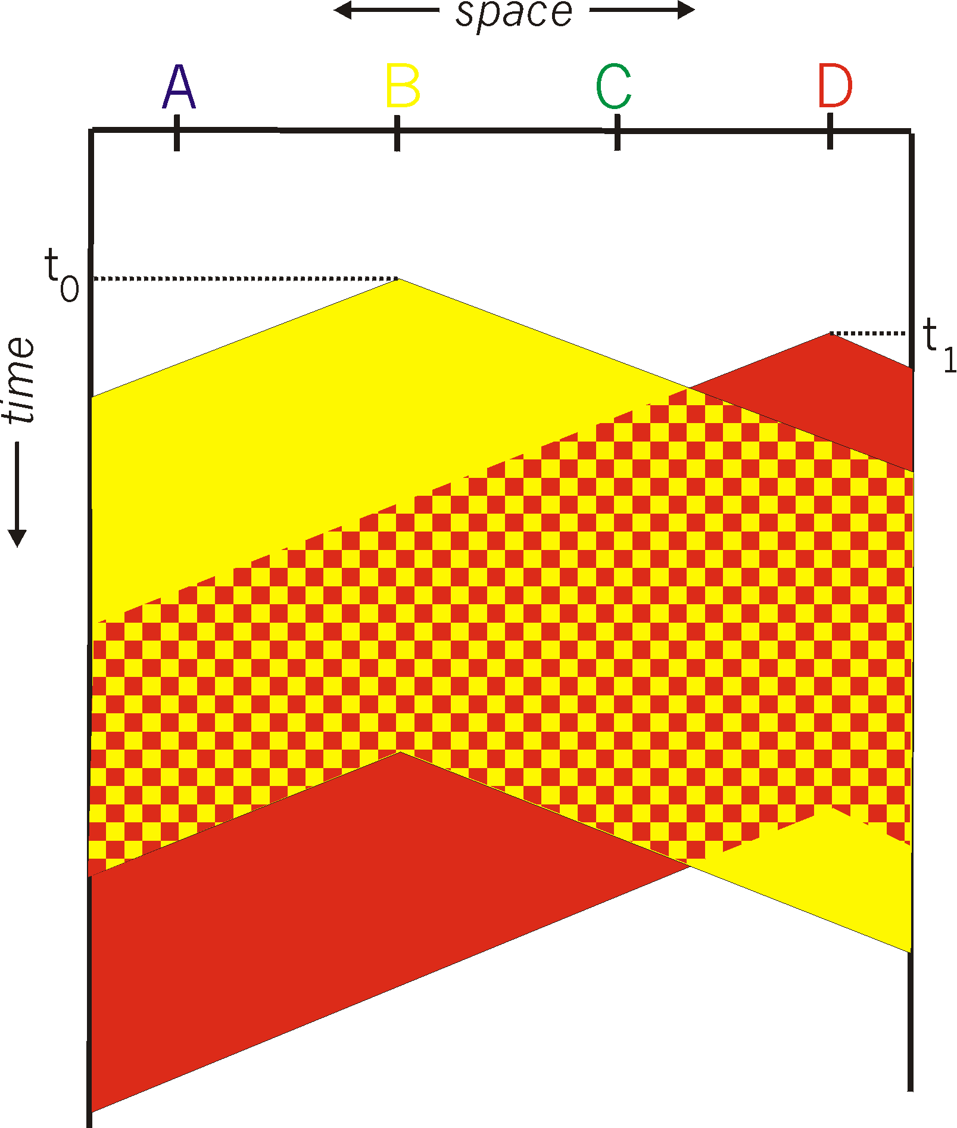
CSMA: collisions
spatial layout of nodes
空间传播延迟导致没有检测到碰撞
collisions can still occur with carrier sensing:
propagation delay causes that two nodes may not hear each other’s just-started transmission
collision: entire packet transmission time wasted
distance & propagation delay play role in determining collision probability
The longer the propagation delay, the higher probability of not being able to sense the transmission that has begun at another node
A B C D

Slide 18
CSMA/CD
Carrier sense multiple access with collision detection
Algorithm
Listen to the channel
If channel is busy, wait until idle
Sending would cause a collision and waste time
Send a frame and sense for collision
If no collision, then frame has been delivered
If collision, abort immediately (stops transmission)
Why keep sending if the frame is already corrupted?
Perform exponential backoff then retransmit
收听频道
如果通道繁忙，则等待空闲
发送会造成碰撞和浪费时间
发送一个帧并检测碰撞
如果没有碰撞，那么帧已经交付
如果碰撞，立即中止
如果帧已经损坏，为什么还要继续发送?
执行指数后退，然后重传

Slide 19
Exponential Backoff
When a sender detects a collision, send “jam signal”
Make sure all hosts are aware of collision
Jam signal is 32 bits long (plus header overhead)
Exponential backoff
Select k ∈ [0, 2^{n} – 1], where n = number of collisions
Wait k * the amount of time required to send 512 bits (e.g., k * 51.2µs for 100 Mbps Ethernet) before retransmission
n is capped at 10, frame dropped after 16 collisions
The size of the sets from which k is chosen grows exponentially with the number of collisions – exponential backoff
当发送方检测到碰撞时，发送“阻塞信号”
确保所有主机都知道碰撞
阻塞信号为32位长(加上报头开销)
选择k [0,2^n-1] n为碰撞次数
k*发送512bit所需时间
n最大为10，16次碰撞后掉帧

